Slide 1
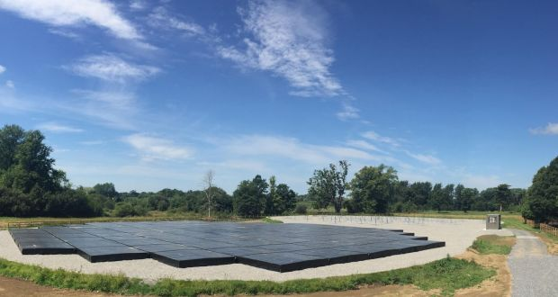
I-LOFAR Single Station Data Analysis
Aoife M. Ryan
Pearse Murphy
Image Credit: Irish Times

Slide 2
Low Band Antennas (LBA)
10-80 MHz

Slide 3
High Band Antennas (HBA)
110-270 MHz

Slide 4
Receiver Units (RCU)
Filters & digitises the signal
192 RCUs

Slide 5
RCU Signal Path
RCU

Slide 6
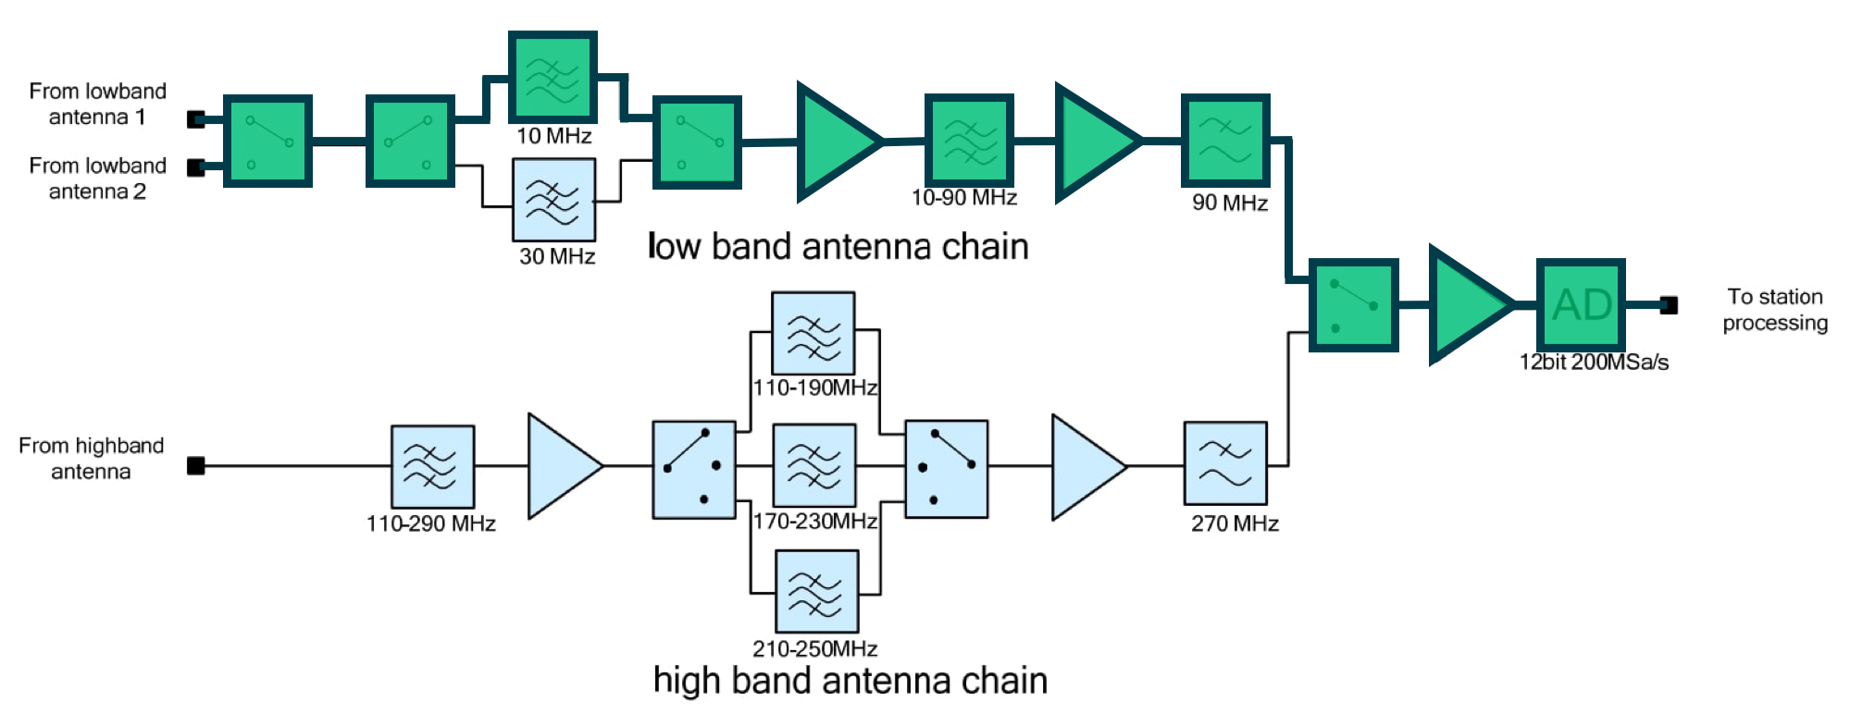
RCU Signal Path – Mode 3
f_{s} = 200 MHz

Slide 7
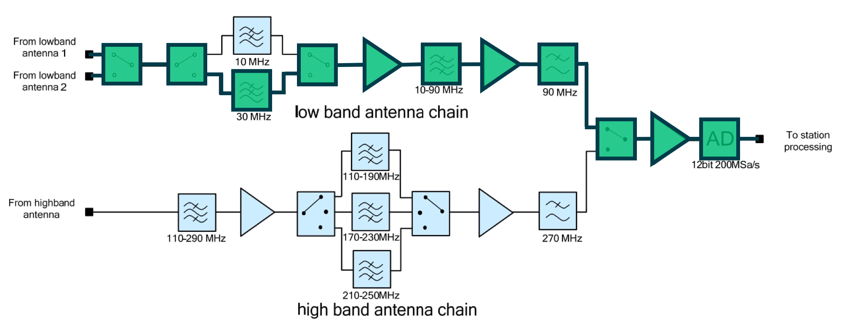
RCU Signal Path – Mode 4
f_{s} = 200 MHz

Slide 8
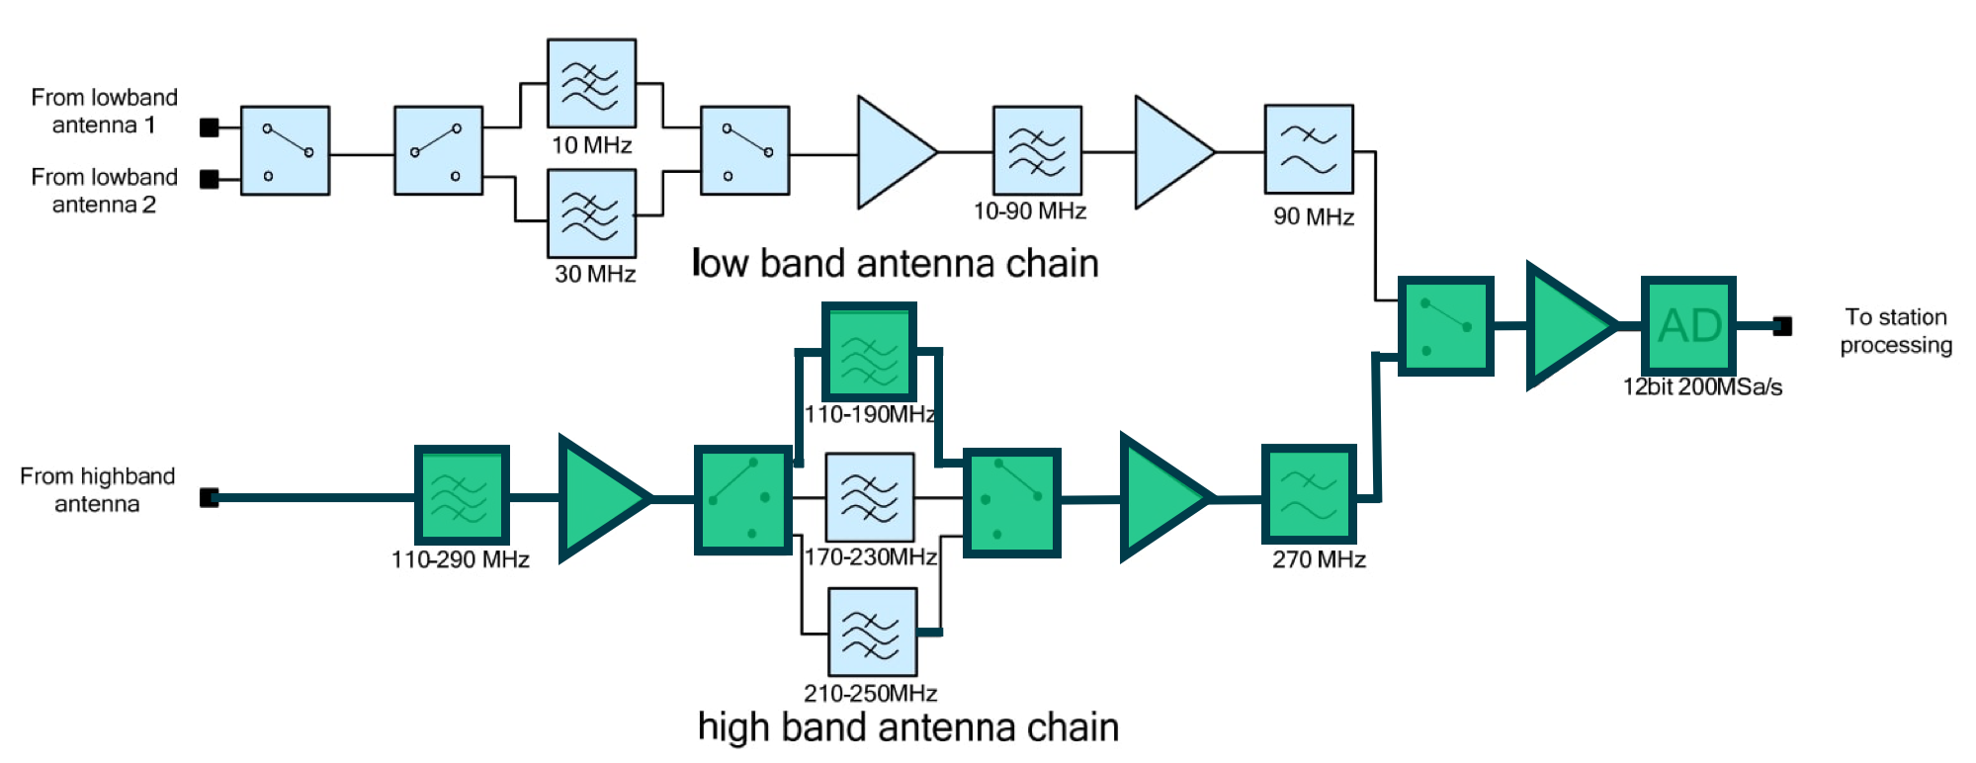
RCU Signal Path – Mode 5
f_{s} = 200 MHz

Slide 9
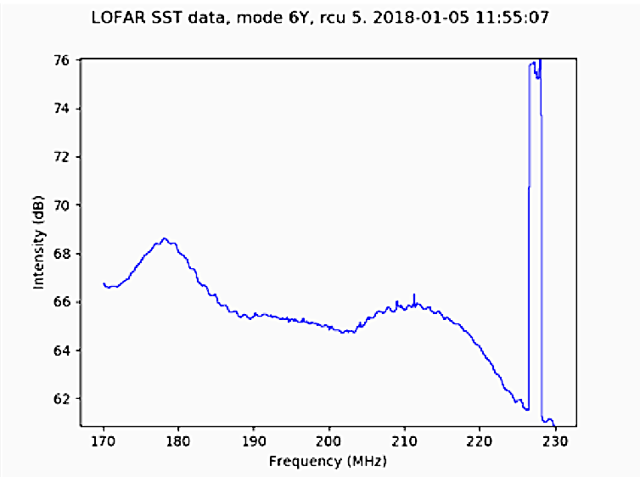
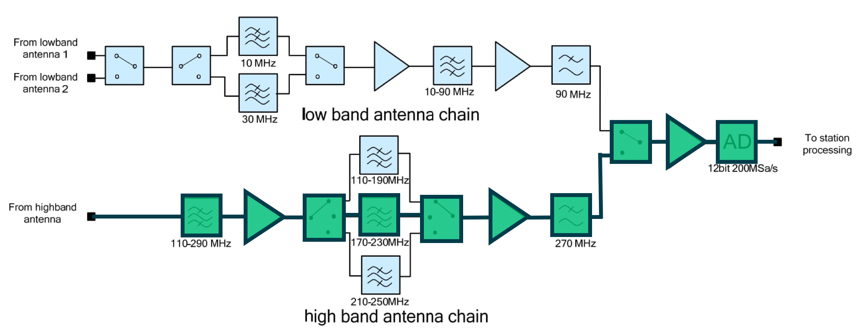
RCU Signal Path – Mode 6
f_{s} = 160 MHz

Slide 10
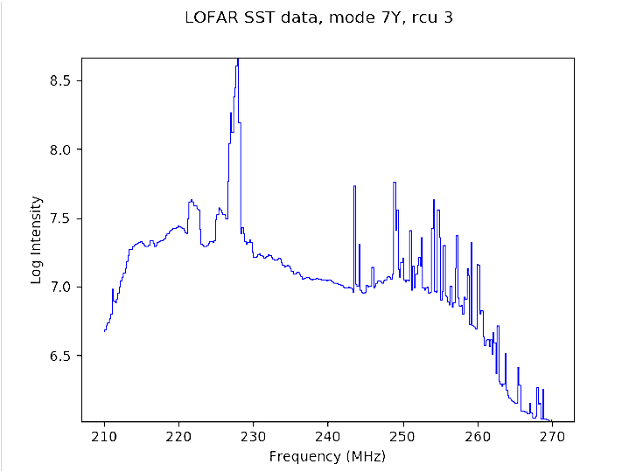
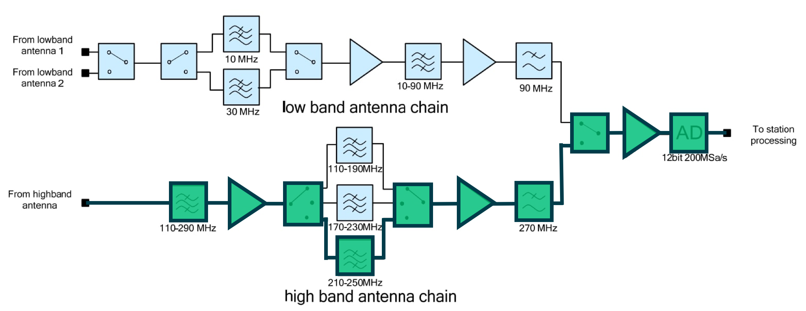
RCU Signal Path – Mode 7
f_{s} = 200 MHz

Slide 11
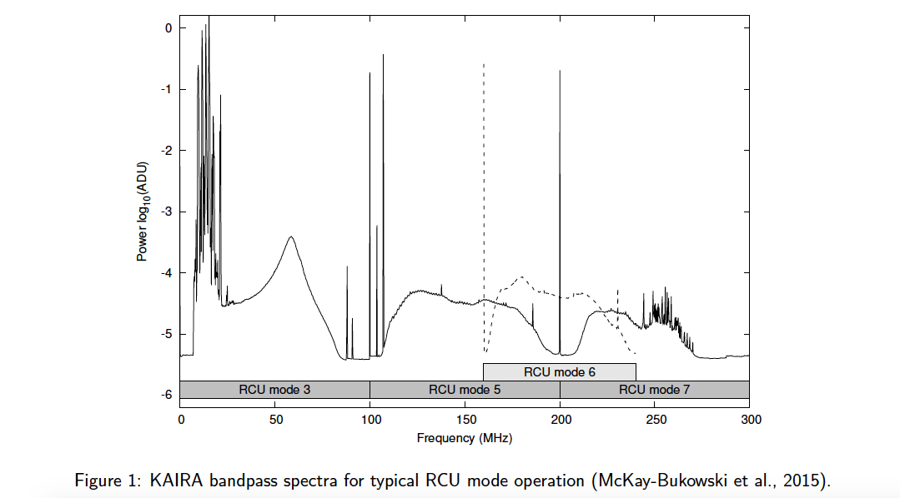
Spectrum for modes 3, 5, 6, 7

Slide 12
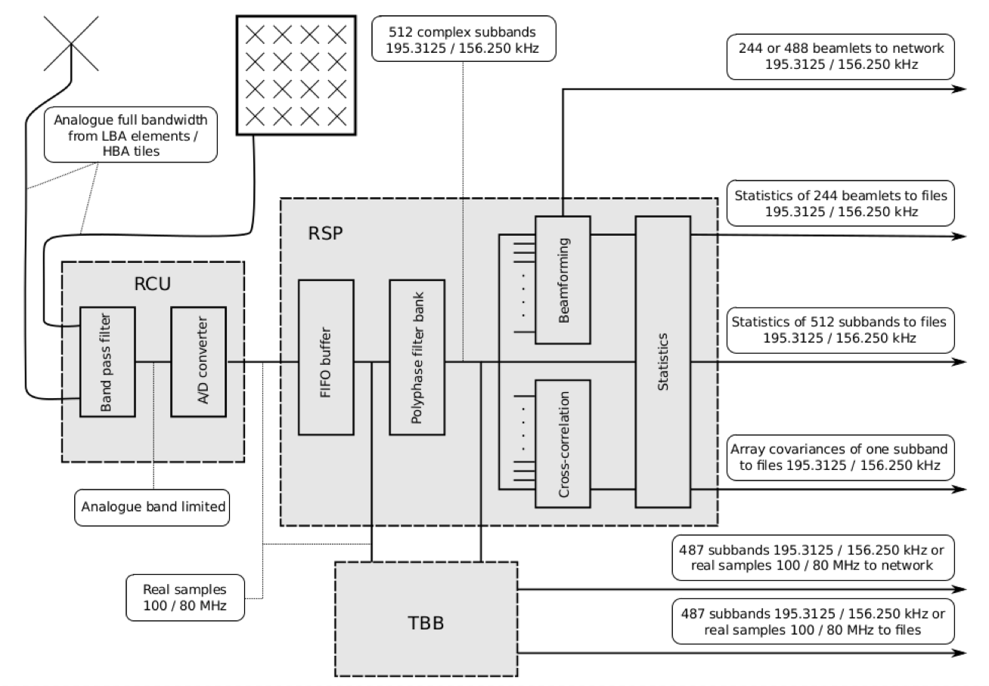
Container Signal Path

Slide 13
Container Signal Path
SST

Slide 14
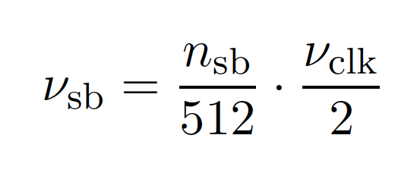
Subband Statistics (SST)
- Used for station diagnostics
- Signal is split into 512 freq. channels or “subbands”
Bandwidth dictated by sampling clock

Slide 15
Subband Statistics (SST)
rspctl --statistics --duration=<seconds>
[--integration=<seconds> --select=<set>
--directory=<directory>]

Slide 16
Subband Statistics (SST)
SST file per RCU
No header
20200303_111500_sst_rcu002.dat

Slide 17
Subband Statistics (SST)
SST file per RCU
No header
20200303_111500_sst_rcu002.dat
date
time
RCU no.
file type

Slide 18
Container Signal Path
TBB

Slide 19
Container Signal Path
XST

Slide 20
Container Signal Path
BST

Slide 21

Beams Beams Beams

Slide 22
Beamlets
Beamlet = subband in a direction
488 (or 244) beamlets per observation
Multiple subbands in same direction
Multiple directions at same subband
Anything in between

Slide 23
Beamlet Statistics (BST)
BST file per polarisation
NO HEADER
20190612_133144_bst_00X.dat
date
time
Polarisation
file type

Slide 24
Mode 357
Mode | 3 | 5 | 7
Beamlets | 0:199 | 200:399 | 400:487
Subbands | 54, 56, 58, … 452 | 54, 56, 58, … 452 | 54, 56, 58, … 228
RCUs | 0:31, 96:127 | 32:63, 128:159 | 64:95, 160:191

Slide 25
Opening a Jupyter notebook over ssh
user@localmachine:~$ ssh visitor_apX@lofar.ap.dias.ie
visitor_apX@lofar:~$ source .venvs/tutorial/bin/activate
visitor_apX@lofar:~$ cd bst_tutorial
visitor_apX@lofar:~$ jupyter notebook --no-browser --port=8889
In a NEW terminal
user@localmachine:~$ ssh -N -f -L localhost:8888:localhost:8889 visitor_apX@lofar.ap.dias.ie
In a browser go to localhost:8888

Slide 26
Plan
Observing modes
Frequencies
Sampling
Spectra (figures)
Antenna signal path (figure)
Container signal path
Show where SST data taken (polyphase filter bank)
What is a subband?
Data format?
What is it useful?
Tutorial
Show where BST data taken (beamforming)….mention cross-correlation produces XST data
What is a beamlet?
Data format?
Tutorial

